Slide 1
CONRICH AREA STRUCTURE PLAN
FUTURE POLICY AREA AMENDMENT
Open House
Prince of Peace Manor & Harbour Banquet Hall
Saturday, October 21, 2023 (1:00 pm to 4:00 pm)
Virtual Open House
Wednesday, October 25, 2023 (5:30 pm to 8:00 pm)

Slide 2
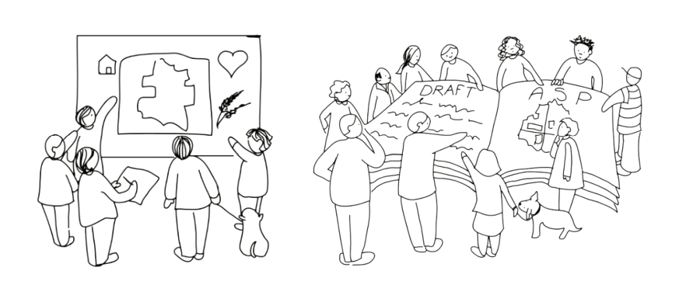
Welcome!
Todays Objectives
To provide an update on the status of the Conrich ASP Future Policy Area Amendments
To obtain your feedback on the draft
To answer your questions
To provide an overview of next steps
Agenda
1. Welcome & Introduction (5 mins)
2. Presentation – Overview of proposed amendments (5 mins)
Proposed Land Use Strategy
Neighbourhood Areas
Density and Phasing
Opportunity for Public Input
3. Modified World Café (Workshop) (40 mins)
Break out into smaller groups of 6-8 people with County staff at each table for Q&A
4. Reporting back (10 mins)
Each group reports backs on one strategic finding or key theme

Slide 3
Project Recap
2015 December – Conrich ASP adopted (effective 2017 following MGB decision)
2018 November – Council approved Terms of Reference for Future Policy Area
2020 July – Administration presented first draft (first reading granted)
2022 August – Calgary Metropolitan Region Growth Plan adopted
2023 October - Project is currently in Phase 4 (Draft Amendments)

Slide 4
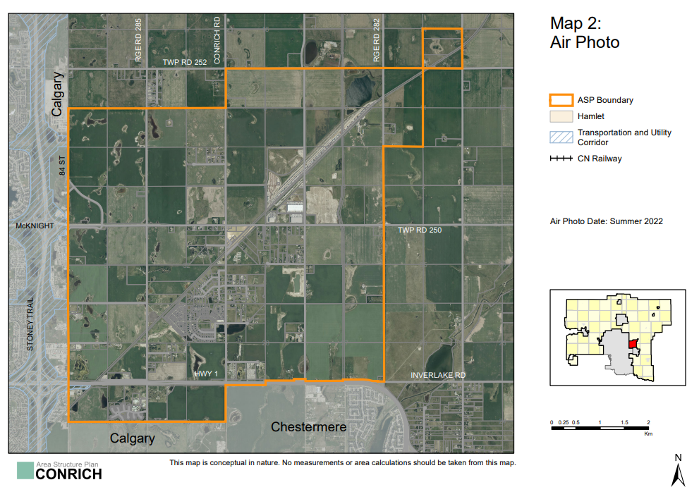
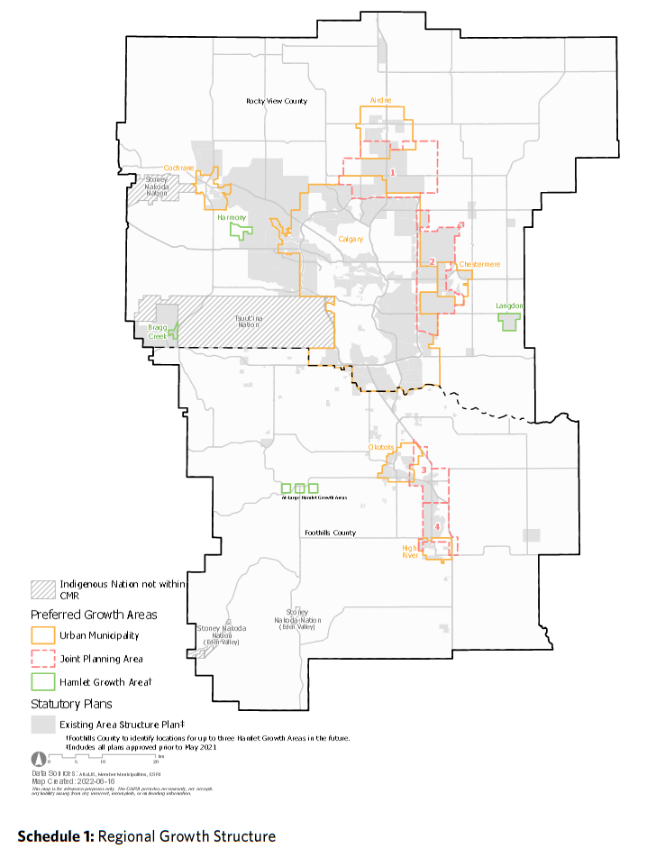
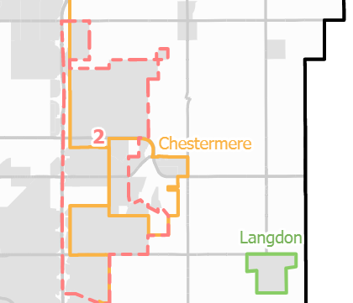
Location Context
Plan Area:
4,344 ha (10,734 ac)
Future Policy Area

Slide 5
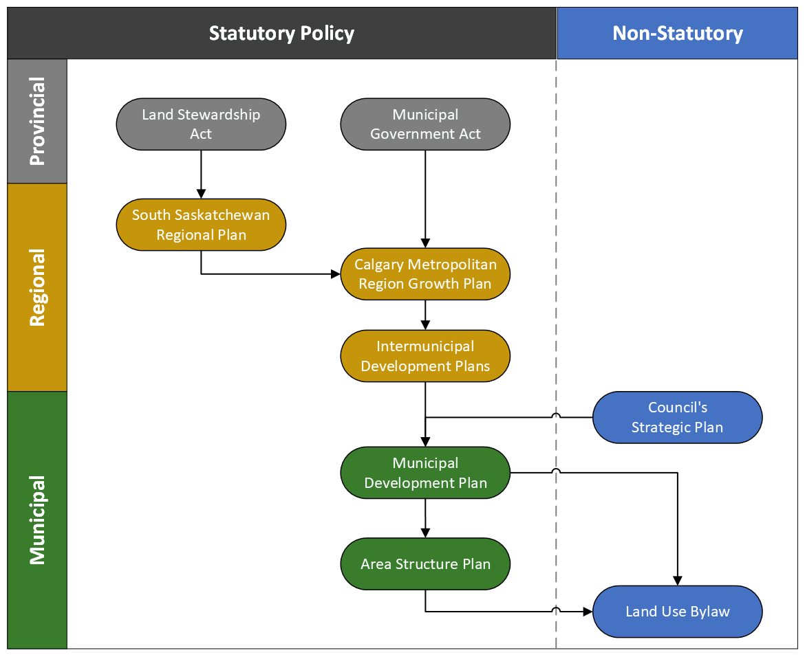
Guiding Policy Framework
Placetypes and minimum average residential densities required by Region Growth Plan

Slide 6
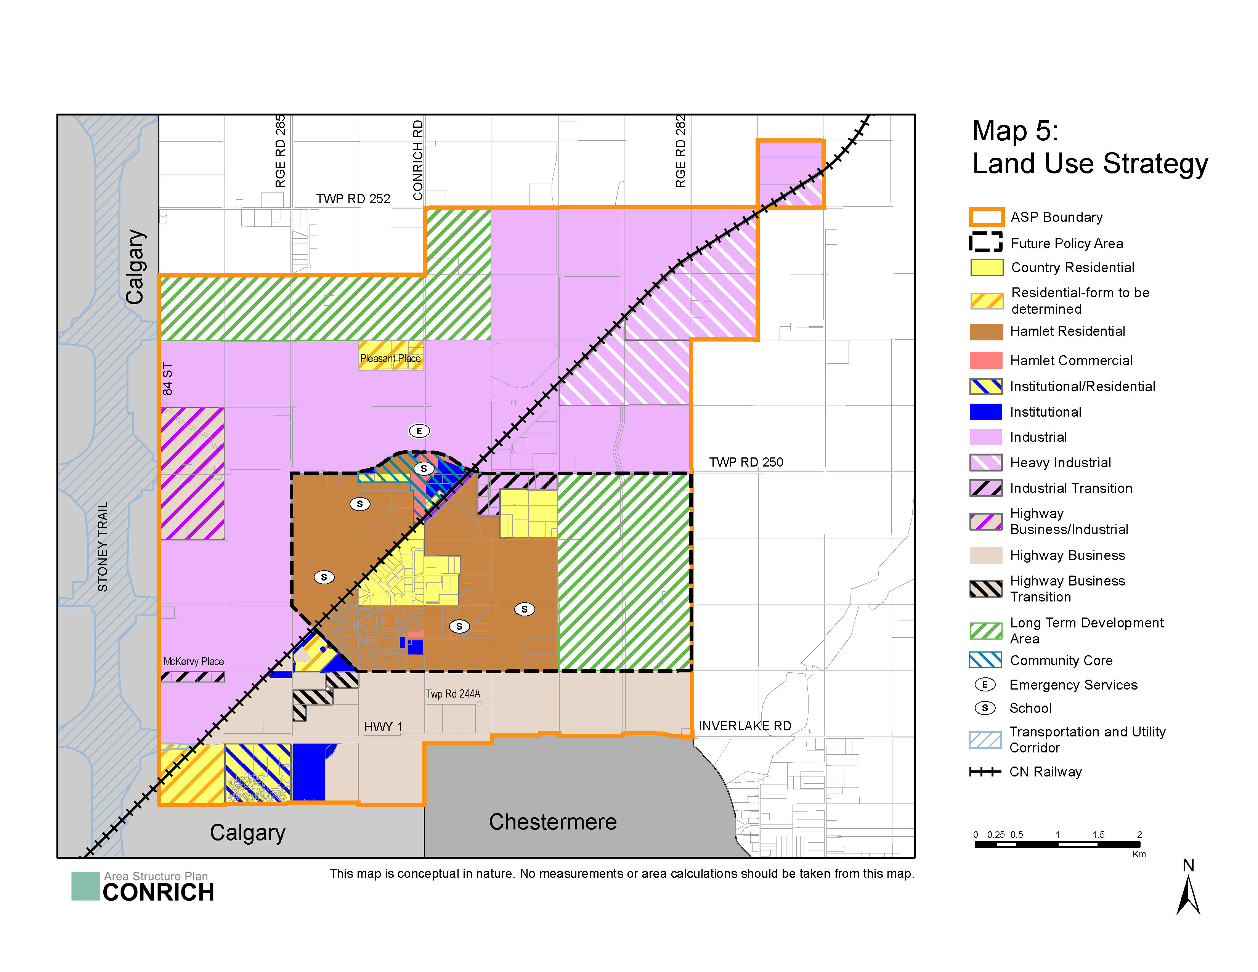
Summary of Amendments
Identification of easternmost portion of the Future Policy Area (FPA) as Long-Term Development Area
Introduction of County-led Local Plans to guide land use and design aspects for:
Community Core
Neighbourhood 1 and Neighbourhood 2
Supports updates and amendments to the Buffalo Hills Conceptual Scheme (Neighbourhood 3)
Minor adjustments to align with technical information

Slide 7
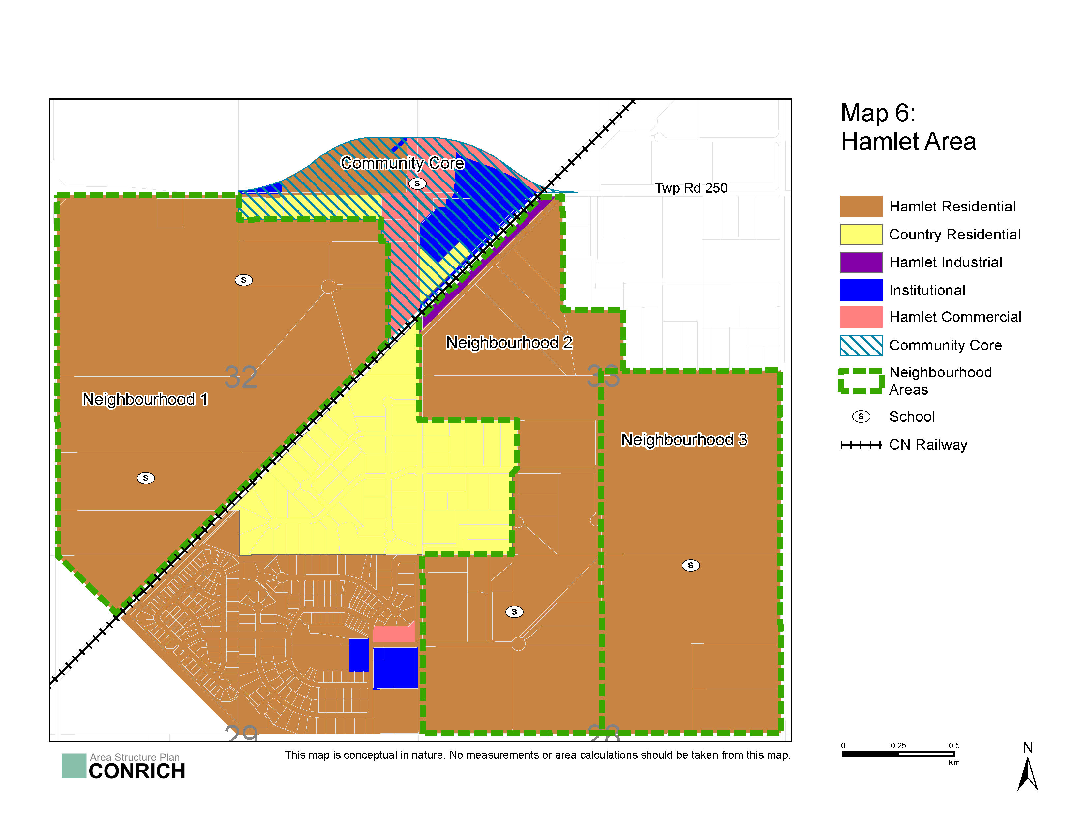
Summary of Amendments
Proposed neighbourhoods consist of Region Growth Plan (RGP) Placetypes
75% Masterplan Communities at 8 upa
25% Residential Community at 5 upa
Increase in overall density from 3.9 upa to 7.25 upa
8,190 homes with approximately 23,400 people within the Hamlet Area
Proposal for nodes of higher density within each neighbourhood area allows for lower density in remainder
Phasing development across three distinct neighbourhood areas and the Community Core
Map 6 shows the established Hamlet Area

Slide 8
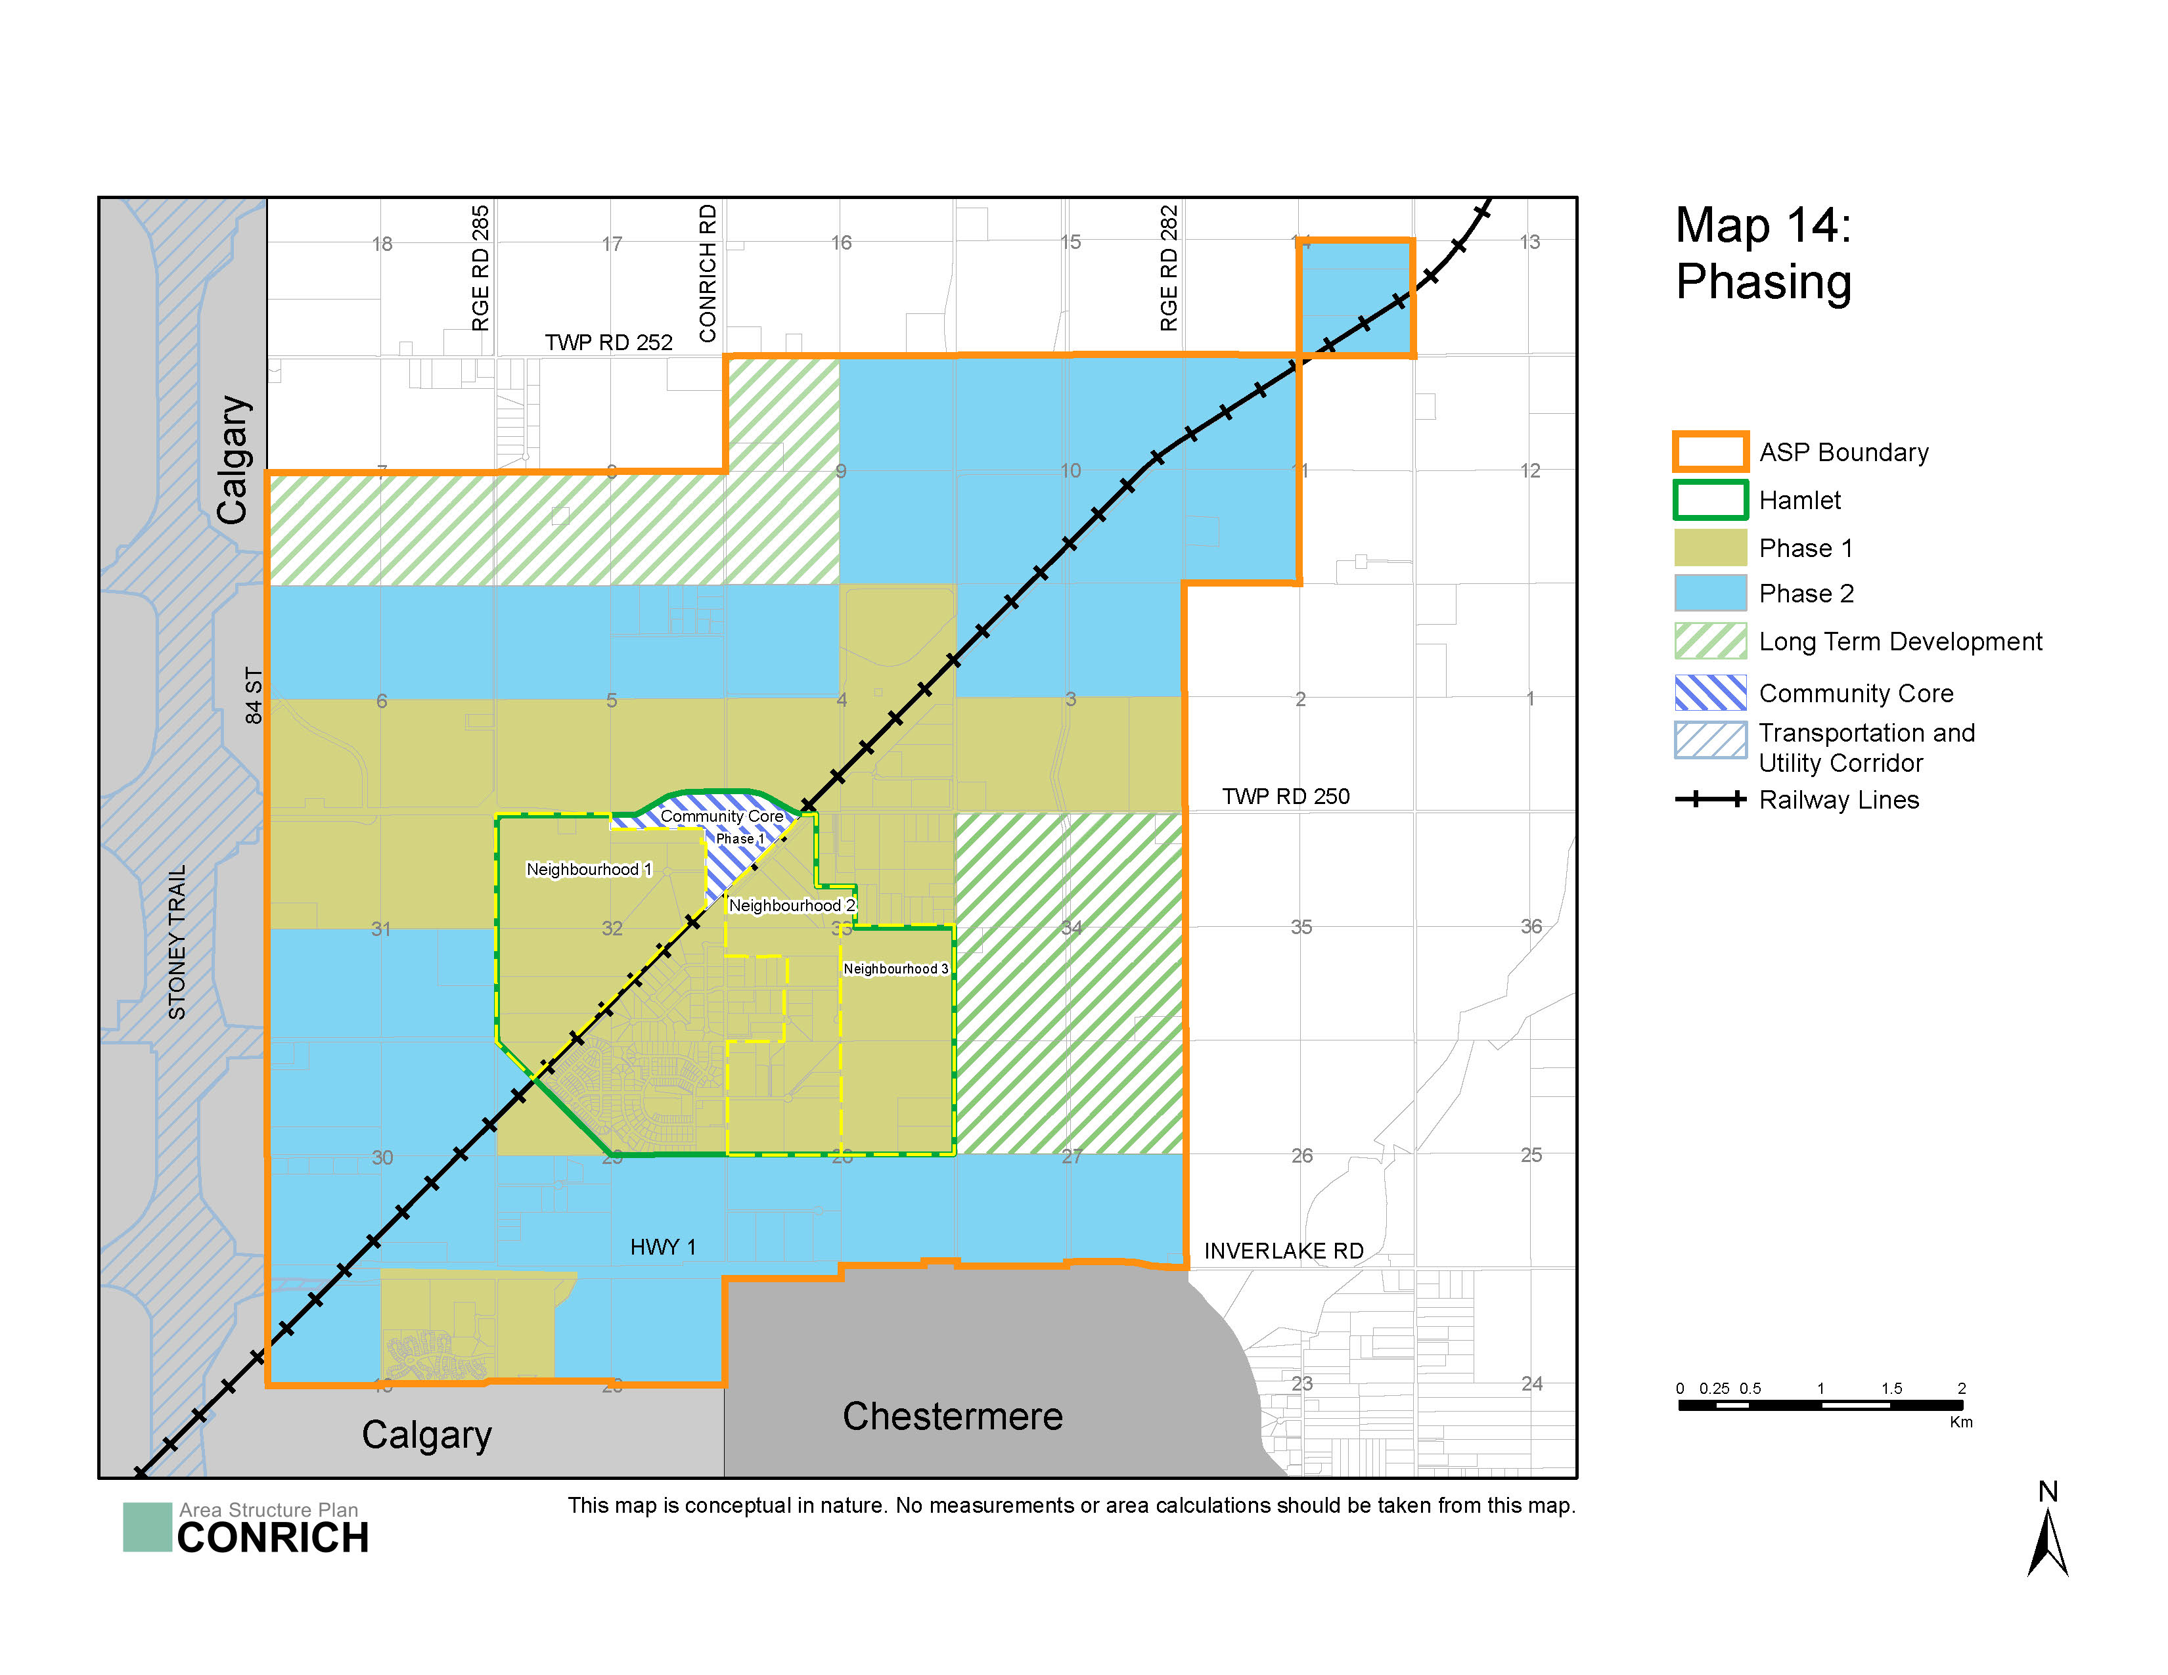
Phasing
Overall Plan phasing as shown in Map 14
Hamlet phasing proposed for Community Core, Neighbourhood 1 and/or Neighbourhood 2 to proceed first before planning rest of the hamlet area through County-led local plans

Slide 9
Next Steps
Q4 2023
Revisions to ASP draft complete
Q4 2023
Community engagement & intermuncipal collaboration
Q4 2023
Final revisions to the draft ASP
Q1 2024 Public Hearing, 1st and 2nd reading of draft ASP
Q1 2024 Referral to Calgary Metropolitan Region Board
Q2 2024 County Council 3rd Reading and adoption of ASP
We are at this stage

Slide 10
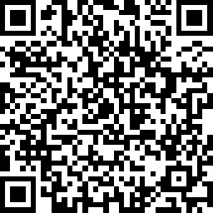
Formal Feedback
Accepting formal feedback till November 5, through:
Online Survey – please scan the QR code to access the Survey
Written Submissions – please provide written submission to planning_policy@rockyview.ca
Visit www.rockyview.ca/conrich-future-policy-area for more information

Slide 11
Discussion Questions
Do you support the proposed Land Use Strategy for the Future Policy Area as shown on Map 5? (10 minutes)
Do you support the proposed neighbourhood areas as shown on Map 6 for comprehensive planning through County-led Local Plans? (10 minutes)
Do you support the proposed Community Core? (10 minutes)
Do you support the proposed development composition that allows for pockets of higher density development to meet the CMRB’s Growth Plan requirement of 7.25 dwelling units per acre? (10 minutes)
What else would you like to share with us?

Slide 12
Thank You for Participating!

